Slide 1
Banking Management System
Group id - 24
TA:Jigar (202111011)
Name-Darshi Desai
Student id-202112113
Name-Nisha Shah
Student id-202112125
Name-Jeemi Thakkar
Student id-202112042
Name-Devam Panchasara
Student id-202112092
Name-Sanjana Shah
Student id-202112033

Slide 2

Scope of the database :
● Our aim is to manage the data of the bank, keep track of all the accounts, customers, departments, branches.
● In addition to that it also helps to manually check the records of the pre-existing system like transactions that were made in the past.
● The main aim of an application is to automate records on the system. It gives all sorts of functions which are required by the bank in order to run a stable system.

Slide 3
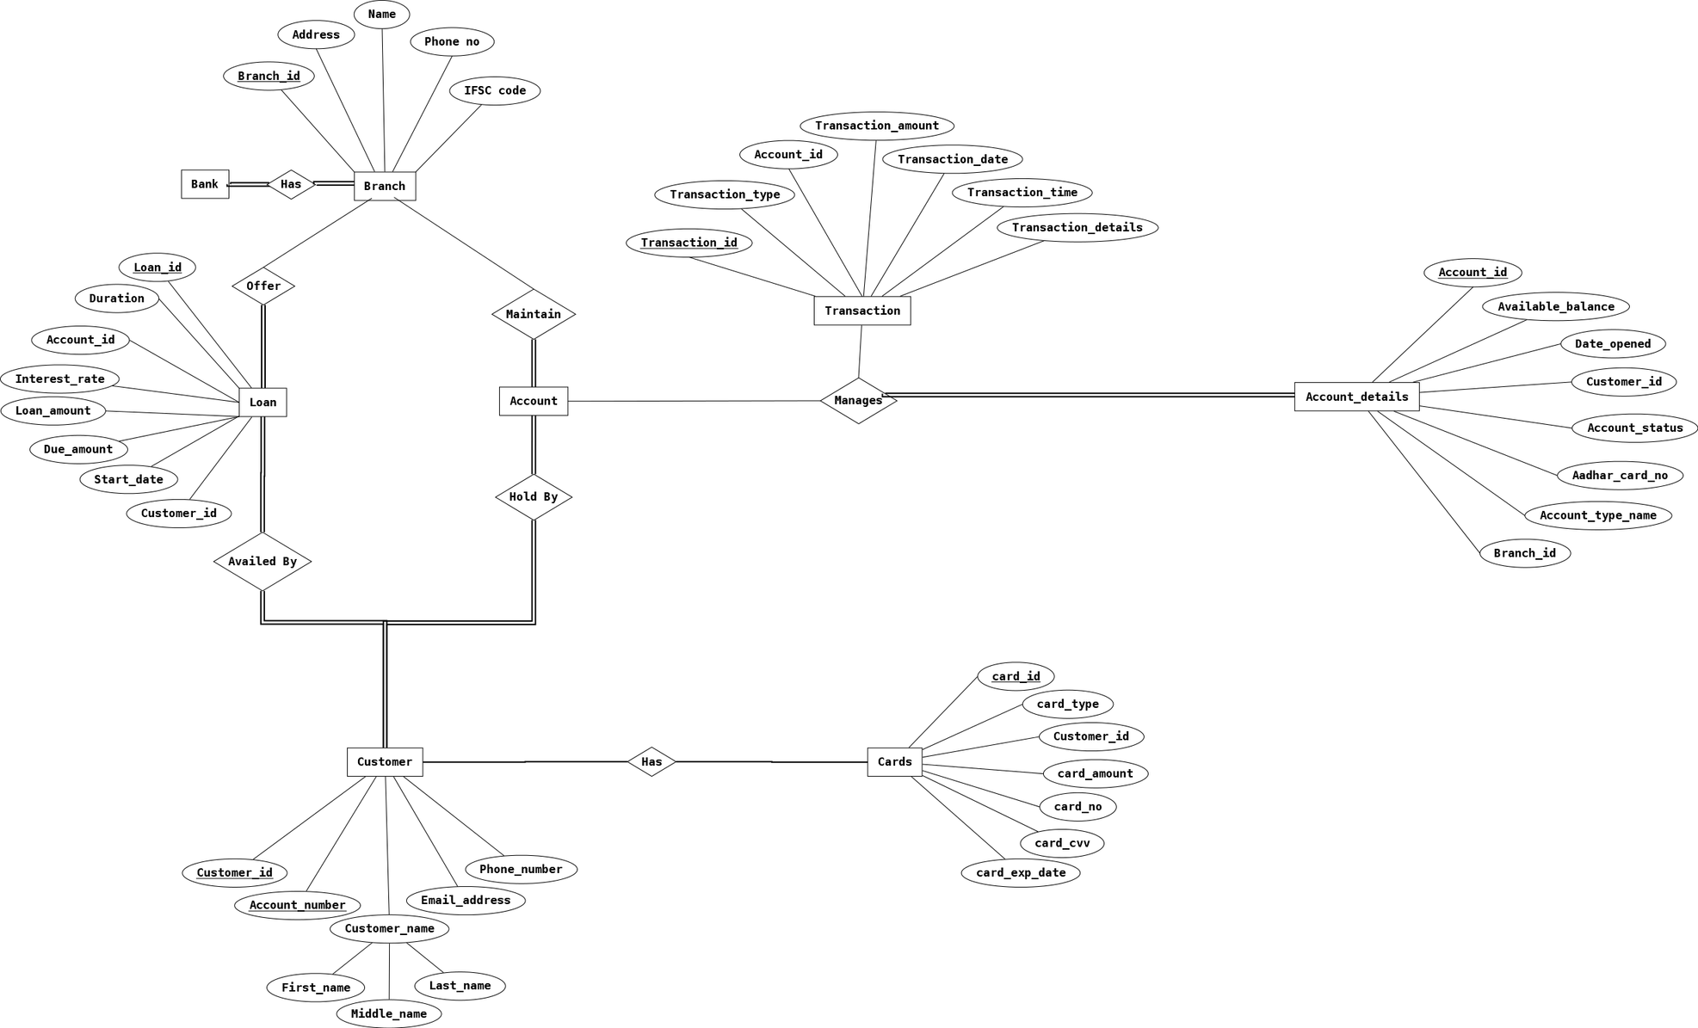
ERD Diagram

Slide 4
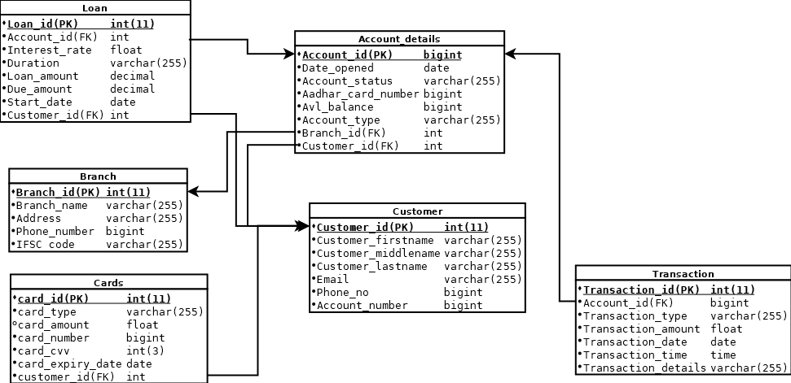
Relational Schema Diagram

Slide 5
FUNCTIONAL DEPENDENCIES AND CONSTRAINTS CLASSIFICATION
Table Name : branch (branch_id, branch_name, address, phone_no, ifsc_code)
Primary Key : branch_id
Functional Dependencies :
branchi_id -> branch_name
branch_id -> address
branch_id -> phone_no
branch_id -> ifsc_code

Slide 6
Constraints :
Primary Key : branch_id
Foreign Key : none
Referential : account_details
Domains :
BRANCH_ID INTEGER NOT NULL,
BRANCH_NAME VARCHAR(255) NOT NULL,
ADDRESS VARCHAR(255) NOT NULL,
PHONE_NO BIGINT NOT NULL,
IFSC_CODE VARCHAR(255) NOT NULL UNIQUE,
PRIMARY KEY (BRANCH_ID)
Candidate Key : branch_id
Here, as we have branch_id as candidate key which defines all the attributes, so our relation is in BCNF Form.

Slide 7
2. Table Name :
Loan (loan_id, interest_rate, duration, loan_amount, due_amount, start_date, account_id, customer_id)
Primary Key : loan_id
Functional Dependencies :
loan_id -> interest_rate
loan_id -> duration
loan_id -> loan_amount
loan_id -> due_amount
loan_id -> start_date

Slide 8
Constraints :
Primary Key : loan_id
Foreign Key : account_id, customer_id
Referential : none
Domains :
LOAN_ID INTEGER PRIMARY KEY,
ACCOUNT_ID INTEGER ,
INTEREST_RATE FLOAT NOT NULL,
DURATION VARCHAR(255) NOT NULL,
LOAN_AMOUNT DECIMAL NOT NULL,
DUE_AMOUNT DECIMAL NOT NULL,
START_DATE DATE NOT NULL,
CUSTOMER_ID INTEGER ,
FOREIGN KEY (CUSTOMER_ID) REFERENCES CUSTOMER(CUSTOMER_ID) ON DELETE SET DEFAULT ON UPDATE CASCADE,
FOREIGN KEY (ACCOUNT_ID) REFERENCES ACCOUNT_DETAILS(ACCOUNT_ID) ON DELETE SET DEFAULT ON UPDATE CASCADE
Candidate Key : loan_id
Here, as we have loan_id as candidate key which defines all the attributes, so our relation is in BCNF Form.

Slide 9
3. Table Name : Customers (customer_id, account_no, customer_firstname, coustomer_middlename, customer_lastname, emai ,phone_no)
Primary Key : customer_id
Functional Dependencies :
customer_id -> account_no
customer_id -> customer_firstname
customer_id -> customer_middlename
customer_id -> customer_lastname
customer_id -> email
customer_id -> phone_no

Slide 10
Constraints :
Primary Key : customer_id
Foreign Key : none
Referential : loan, cards, account_details
Domains :
CUSTOMER_ID INTEGER PRIMARY KEY,
ACCOUNT_NO BIGINT NOT NULL UNIQUE,
CUSTOMER_FIRSTNAME VARCHAR(255) NOT NULL,
CUSTOMER_MIDDLENAME VARCHAR(255) NOT NULL,
CUSTOMER_LASTNAME VARCHAR(255) NOT NULL,
EMAIL VARCHAR(255) NOT NULL CHECK (EMAIL LIKE '%@%.%' AND EMAIL NOT LIKE '@%' AND EMAIL NOT LIKE '%@%@%'),
PHONE_NO BIGINT NOT NULL
Candidate Key : customer_id, account_no
Here, as we have customer_id and account_no as candidate keys which defines all the attributes, so our relation is in BCNF Form.

Slide 11
4. Table Name : Cards (card_id, card_number, card_type, card_amount, card_CVV, card_expiry_date, customer_id)
Primary Key : card_id
Functional Dependencies :
card_id ->card_number
card_id ->card_type
card_id ->card_amount
card_id ->card_CVV
card_id -> card_expiry_date

Slide 12
Constraints :
Primary Key : card_id
Foreign Key : customer_id
Referential : none
Domains :
CARD_ID INTEGER PRIMARY KEY,
CARD_TYPE VARCHAR(255) NOT NULL,
CARD_AMOUNT FLOAT,
CARD_NUMBER BIGINT NOT NULL,
CARD_CVV INTEGER NOT NULL,
CARD_EXPIRYDATE DATE NOT NULL,
CUSTOMER_ID INTEGER,
FOREIGN KEY (CUSTOMER_ID) REFERENCES CUSTOMER(CUSTOMER_ID) ON DELETE SET DEFAULT ON UPDATE CASCADE
Candidate Key : card_id
Here, as we have card_id as candidate keys which defines all the attributes, so our relation is in BCNF Form.

Slide 13
5. Table Name : Account_details (account_id, date_opened , aadhar_card_number, account _status, account _type, customer_id, branch_id)
Primary Key : account_id
Functional Dependencies :
account_id -> date_opened
account_id -> accout_status
account_id -> aadhar_card_number
account_id -> avl_balance
account_id -> account_type

Slide 14
Constraints :
Primary Key : account_id
Foreign Key : customer_id, branch_id
Referential : loan, transaction
Domains :
ACCOUNT_ID BIGINT PRIMARY KEY,
DATE_OPENED DATE NOT NULL,
ACCOUNT_STATUS VARCHAR(255) NOT NULL,
AADHAR_CARD_NUMBER BIGINT NOT NULL,
AVL_BALANCE BIGINT DEFAULT 5000,
ACCOUNT_TYPE VARCHAR(255) NOT NULL,
CUSTOMER_ID INTEGER , FOREIGN KEY (CUSTOMER_ID) REFERENCES CUSTOMER(CUSTOMER_ID) ON DELETE SET DEFAULT ON UPDATE CASCADE,
BRANCH_ID INTEGER , FOREIGN KEY (BRANCH_ID) REFERENCES BRANCH(BRANCH_ID) ON DELETE SET DEFAULT ON UPDATE CASCADE
Candidate Key : account_id
Here, as we have account_id as candidate keys which defines all the attributes, so our relation is in BCNF Form.

Slide 15
6. Table Name : Transactions(transaction_id, transaction _type, transaction_amount, transaction_date, transaction_time, transaction_details, account_id)
Primary Key : transaction_id
Functional Dependencies :
transaction _id -> account_id
transaction _id -> transaction_type
transaction _id -> transaction _amount
transaction _id -> transaction _date
transaction _id -> transaction _time

Slide 16
Constraints :
Primary Key : transaction_id
Foreign Key : account_id
Referential : none
Domains :
TRANSACTION_ID INTEGER PRIMARY KEY,
ACCOUNT_ID BIGINT,
TRANSACTION_TYPE VARCHAR(255) NOT NULL ,
TRANSACTION_AMOUNT FLOAT NOT NULL CHECK (TRANSACTION_AMOUNT>0), TRANSACTION_DATE DATE NOT NULL , TRANSACTION_TIME TIME NOT NULL, TRANSACTION_DETAILS VARCHAR(255) NOT NULL ,
FOREIGN KEY (ACCOUNT_ID) REFERENCES ACCOUNT_DETAILS(ACCOUNT_ID) ON DELETE SET DEFAULT ON UPDATE CASCADE
Candidate Key : transaction_id
Here, as we have transaction _id as candidate keys which defines all the attributes, so our relation is in BCNF Form.
As all the attributes are directly dependent on the key, the relation is in BCNF. As it is in BCNF it also confirms 3NF, 2NF and 1NF

Slide 17
Insert Tables Queries->

Slide 18
1. Customer Table insertion
INSERT INTO customer (CUSTOMER_ID,ACCOUNT_NO,CUSTOMER_FIRSTNAME,CUSTOMER_MIDDLENAME,CUSTOMER_LASTNAME,EMAIL,PHONE_NO) VALUES (1, 5600012549,'Anish','Vipul','shah', 'Anish21@gmail.com', 4859685726 );
INSERT INTO customer (CUSTOMER_ID,ACCOUNT_NO,CUSTOMER_FIRSTNAME,CUSTOMER_MIDDLENAME,CUSTOMER_LASTNAME,EMAIL,PHONE_NO) VALUES (2, 5600012345,'Darshi','Rakesh','Desai', 'Darshi15@gmail.com', 4859686526 );
INSERT INTO customer (CUSTOMER_ID,ACCOUNT_NO,CUSTOMER_FIRSTNAME,CUSTOMER_MIDDLENAME,CUSTOMER_LASTNAME,EMAIL,PHONE_NO) VALUES (3, 5600012456,'Nisha','Rupesh','shah', 'Nisha08@gmail.com', 4859685722 );
INSERT INTO customer (CUSTOMER_ID,ACCOUNT_NO,CUSTOMER_FIRSTNAME,CUSTOMER_MIDDLENAME,CUSTOMER_LASTNAME,EMAIL,PHONE_NO) VALUES (4, 5600012351,'Devam','Nalin','Panchasara', 'Devam12@gmail.com', 4851286526 );
INSERT INTO customer (CUSTOMER_ID,ACCOUNT_NO,CUSTOMER_FIRSTNAME,CUSTOMER_MIDDLENAME,CUSTOMER_LASTNAME,EMAIL,PHONE_NO) VALUES (5, 5600012414,'Jeemi','Anil','Thakkar', 'Jeemi08@gmail.com', 4456689432 );
INSERT INTO customer (CUSTOMER_ID,ACCOUNT_NO,CUSTOMER_FIRSTNAME,CUSTOMER_MIDDLENAME,CUSTOMER_LASTNAME,EMAIL,PHONE_NO) VALUES (6, 5600012111,'Sanjana','Mahesh','shah', 'Sanjana15@gmail.com', 4859681226 );
INSERT INTO customer (CUSTOMER_ID,ACCOUNT_NO,CUSTOMER_FIRSTNAME,CUSTOMER_MIDDLENAME,CUSTOMER_LASTNAME,EMAIL,PHONE_NO) VALUES (7, 5600012559,'Drishti','Ankit','Desai', 'Drishti26@gmail.com', 4859586726 );
INSERT INTO customer (CUSTOMER_ID,ACCOUNT_NO,CUSTOMER_FIRSTNAME,CUSTOMER_MIDDLENAME,CUSTOMER_LASTNAME,EMAIL,PHONE_NO) VALUES (8, 5600012574,'Akshay','Haresh','Patel', 'Akshay19@gmail.com', 4859581936 );
INSERT INTO customer (CUSTOMER_ID,ACCOUNT_NO,CUSTOMER_FIRSTNAME,CUSTOMER_MIDDLENAME,CUSTOMER_LASTNAME,EMAIL,PHONE_NO) VALUES (9, 5600012220,'Aangi','Kamlesh','Shah', 'aangi24@gmail.com', 4859685444 );
INSERT INTO customer (CUSTOMER_ID,ACCOUNT_NO,CUSTOMER_FIRSTNAME,CUSTOMER_MIDDLENAME,CUSTOMER_LASTNAME,EMAIL,PHONE_NO) VALUES (10,5600012550,'Aesha','Rajesh','Shah', 'aesha21@gmail.com', 4859685423 );

Slide 19
2. Branch Table insertion
INSERT INTO BRANCH (BRANCH_ID,BRANCH_NAME,ADDRESS,PHONE_NO,IFSC_CODE) VALUES (1,'BOB Adval','Adval, Tal. Dhandhuka, Ahmedabad - 382460Adval , Gujarat',4859685423, 'BARB0ADVALX' );
INSERT INTO BRANCH (BRANCH_ID,BRANCH_NAME,ADDRESS,PHONE_NO,IFSC_CODE) VALUES (2,'BOB Ahmedabad','Post Box 101, Fuvara, Gandhi Road, Ahmedabad - 380001 Gujarat',4859685411, 'BARB0GANAHM' );
INSERT INTO BRANCH (BRANCH_ID,BRANCH_NAME,ADDRESS,PHONE_NO,IFSC_CODE) VALUES (3,'BOB Akhabarnagar','Millenium Plaza Akhabarnagar Circle Nava Wadaj, Ahmedabad - 38001 Gujarat',4859685421, 'BARB0AKHABA' );
INSERT INTO BRANCH (BRANCH_ID,BRANCH_NAME,ADDRESS,PHONE_NO,IFSC_CODE) VALUES (4,'BOB Ambawadi','Ambawadi Branch, Panchvati, Ahemdabad, Pin - 380006, Gujarat',4859685455, 'BARB0AMBAWA' );
INSERT INTO BRANCH (BRANCH_ID,BRANCH_NAME,ADDRESS,PHONE_NO,IFSC_CODE) VALUES (5,'BOB JIVRAJ','132 Ring Road, Ahmedabad - 380051 Gujarat',4829681831, 'BARB0JIVRAJ' );

Slide 20
3. Loan Table insertion
INSERT INTO LOAN (LOAN_ID,INTEREST_RATE,DURATION,LOAN_AMOUNT,DUE_AMOUNT,START_DATE,CUSTOMER_ID,ACCOUNT_ID) VALUES (1,8.0,'3 Years',500000,350000,'20-Nov-21',1,3);
INSERT INTO LOAN (LOAN_ID,INTEREST_RATE,DURATION,LOAN_AMOUNT,DUE_AMOUNT,START_DATE,CUSTOMER_ID,ACCOUNT_ID) VALUES (2,9.5,'5 Years',1000000,650000,'10-mar-21',2,7);
INSERT INTO LOAN (LOAN_ID,INTEREST_RATE,DURATION,LOAN_AMOUNT,DUE_AMOUNT,START_DATE,CUSTOMER_ID,ACCOUNT_ID) VALUES (3,7.5,'2 Years',100000,75000,'8-may-21',3,3);
INSERT INTO LOAN (LOAN_ID,INTEREST_RATE,DURATION,LOAN_AMOUNT,DUE_AMOUNT,START_DATE,CUSTOMER_ID,ACCOUNT_ID) VALUES (4,6,'1 Years',50000,45000,'5-oct-21',5,14);
INSERT INTO LOAN (LOAN_ID,INTEREST_RATE,DURATION,LOAN_AMOUNT,DUE_AMOUNT,START_DATE,CUSTOMER_ID,ACCOUNT_ID) VALUES (5,12,'10 Years',5000000,3000000,'28-nov-17',8,7);

Slide 21
4. Account_Details Table insertion
INSERT INTO ACCOUNT_DETAILS (ACCOUNT_ID,DATE_OPENED,ACCOUNT_STATUS,AADHAR_CARD_NUMBER,ACCOUNT_TYPE,CUSTOMER_ID,BRANCH_ID) VALUES (1,'20-dec-18','Active','123456789012','Current',1,1);
INSERT INTO ACCOUNT_DETAILS (ACCOUNT_ID,DATE_OPENED,ACCOUNT_STATUS,AADHAR_CARD_NUMBER,ACCOUNT_TYPE,CUSTOMER_ID,BRANCH_ID) VALUES (2,'2-sep-16','Active','123456879021','Fixed',2,2);
INSERT INTO ACCOUNT_DETAILS (ACCOUNT_ID,DATE_OPENED,ACCOUNT_STATUS,AADHAR_CARD_NUMBER,ACCOUNT_TYPE,CUSTOMER_ID,BRANCH_ID) VALUES (3,'20-mar-14','Active','321456879021','Savings',3,3);
INSERT INTO ACCOUNT_DETAILS (ACCOUNT_ID,DATE_OPENED,ACCOUNT_STATUS,AADHAR_CARD_NUMBER,ACCOUNT_TYPE,CUSTOMER_ID,BRANCH_ID) VALUES (4,'15-jun-14','Active','321465879021','Savings',4,4);
INSERT INTO ACCOUNT_DETAILS (ACCOUNT_ID,DATE_OPENED,ACCOUNT_STATUS,AADHAR_CARD_NUMBER,ACCOUNT_TYPE,CUSTOMER_ID,BRANCH_ID) VALUES (5,'19-oct-18','Active','311475680921','Current',5,5);
INSERT INTO ACCOUNT_DETAILS (ACCOUNT_ID,DATE_OPENED,ACCOUNT_STATUS,AADHAR_CARD_NUMBER,ACCOUNT_TYPE,CUSTOMER_ID,BRANCH_ID) VALUES (6,'1-nov-18','Active','123455579021','Fixed',6,1);
INSERT INTO ACCOUNT_DETAILS (ACCOUNT_ID,DATE_OPENED,ACCOUNT_STATUS,AADHAR_CARD_NUMBER,ACCOUNT_TYPE,CUSTOMER_ID,BRANCH_ID) VALUES (7,'20-mar-14','Active','321456666021','Savings',7,2);
INSERT INTO ACCOUNT_DETAILS (ACCOUNT_ID,DATE_OPENED,ACCOUNT_STATUS,AADHAR_CARD_NUMBER,ACCOUNT_TYPE,CUSTOMER_ID,BRANCH_ID) VALUES (8,'8-may-20','Active','134625879021','Fixed',8,3);
INSERT INTO ACCOUNT_DETAILS (ACCOUNT_ID,DATE_OPENED,ACCOUNT_STATUS,AADHAR_CARD_NUMBER,ACCOUNT_TYPE,CUSTOMER_ID,BRANCH_ID) VALUES (9,'19-oct-20','Active','311475680000','Current',9,4);
INSERT INTO ACCOUNT_DETAILS (ACCOUNT_ID,DATE_OPENED,ACCOUNT_STATUS,AADHAR_CARD_NUMBER,ACCOUNT_TYPE,CUSTOMER_ID,BRANCH_ID) VALUES (10,'20-oct-18','Active','311465780921','Current',10,5);
INSERT INTO ACCOUNT_DETAILS (ACCOUNT_ID,DATE_OPENED,ACCOUNT_STATUS,AADHAR_CARD_NUMBER,ACCOUNT_TYPE,CUSTOMER_ID,BRANCH_ID) VALUES (11,'21-Feb-16','Active','321465879021','Current',4,2);
INSERT INTO ACCOUNT_DETAILS (ACCOUNT_ID,DATE_OPENED,ACCOUNT_STATUS,AADHAR_CARD_NUMBER,ACCOUNT_TYPE,CUSTOMER_ID,BRANCH_ID) VALUES (13,'1-Dec-20','Active','123455579021','Current',6,1);
INSERT INTO ACCOUNT_DETAILS (ACCOUNT_ID,DATE_OPENED,ACCOUNT_STATUS,AADHAR_CARD_NUMBER,ACCOUNT_TYPE,CUSTOMER_ID,BRANCH_ID) VALUES (14,'10-Apr-20','Active','123456789012','Savings',4,2);
INSERT INTO ACCOUNT_DETAILS (ACCOUNT_ID,DATE_OPENED,ACCOUNT_STATUS,AADHAR_CARD_NUMBER,AVL_BALANCE,ACCOUNT_TYPE,CUSTOMER_ID,BRANCH_ID) VALUES (15,'20-Dec-21','Active','132465978102',10000,'Savings',6,3);

Slide 22
5. Card Table insertion
INSERT INTO CARDS(CARD_ID,CARD_TYPE,CARD_NUMBER,CARD_CVV,CARD_EXPIRYDATE,CUSTOMER_ID)VALUES(1,'Debit','2624970525726523','415','04-dec-2018',1);
INSERT INTO CARDS(CARD_ID,CARD_TYPE,CARD_AMOUNT,CARD_NUMBER,CARD_CVV,CARD_EXPIRYDATE,CUSTOMER_ID)VALUES(2,'Credit','100000','4977557004155495','615','15-dec-2018',9);
INSERT INTO CARDS(CARD_ID,CARD_TYPE,CARD_NUMBER,CARD_CVV,CARD_EXPIRYDATE,CUSTOMER_ID)VALUES(3,'Debit','4555970549833015','629','04-jan-2020',4);
INSERT INTO CARDS(CARD_ID,CARD_TYPE,CARD_AMOUNT,CARD_NUMBER,CARD_CVV,CARD_EXPIRYDATE,CUSTOMER_ID)VALUES(4,'Credit','50000','4062974550323615','252','04-sep-2019',8);
INSERT INTO CARDS(CARD_ID,CARD_TYPE,CARD_NUMBER,CARD_CVV,CARD_EXPIRYDATE,CUSTOMER_ID)VALUES(5,'Debit','4062974550323615','252','04-sep-2019',5);

Slide 23
6. Transaction Table insertion
INSERT INTO TRANSACTIONS (TRANSACTION_ID,TRANSACTION_TYPE,TRANSACTION_DETAILS,TRANSACTION_AMOUNT,TRANSACTION_DATE,TRANSACTION_TIME,ACCOUNT_ID) VALUES (1,'CASH','DEBIT',3000, '20-Dec-18','18:53:04',1);
INSERT INTO TRANSACTIONS (TRANSACTION_ID,TRANSACTION_TYPE,TRANSACTION_DETAILS,TRANSACTION_AMOUNT,TRANSACTION_DATE,TRANSACTION_TIME,ACCOUNT_ID) VALUES (2,'CASH','CREDIT',4000, '20-Dec-20','14:08:04',3);
INSERT INTO TRANSACTIONS (TRANSACTION_ID,TRANSACTION_TYPE,TRANSACTION_DETAILS,TRANSACTION_AMOUNT,TRANSACTION_DATE,TRANSACTION_TIME,ACCOUNT_ID) VALUES (3,'CHEQUE','CREDIT',10000, '06-Mar-21','10:48:42',5);
INSERT INTO TRANSACTIONS (TRANSACTION_ID,TRANSACTION_TYPE,TRANSACTION_DETAILS,TRANSACTION_AMOUNT,TRANSACTION_DATE,TRANSACTION_TIME,ACCOUNT_ID) VALUES (4,'CARD','DEBIT',2000, '08-Jan-22','23:17:14',7);
INSERT INTO TRANSACTIONS (TRANSACTION_ID,TRANSACTION_TYPE,TRANSACTION_DETAILS,TRANSACTION_AMOUNT,TRANSACTION_DATE,TRANSACTION_TIME,ACCOUNT_ID) VALUES (5,'CARD','CREDIT',25000, '14-Jul-21','21:34:48',10);
INSERT INTO TRANSACTIONS (TRANSACTION_ID,TRANSACTION_TYPE,TRANSACTION_DETAILS,TRANSACTION_AMOUNT,TRANSACTION_DATE,TRANSACTION_TIME,ACCOUNT_ID) VALUES (6,'CASH','CREDIT',7000, '20-Dec-18','13:40:48',4);
INSERT INTO TRANSACTIONS (TRANSACTION_ID,TRANSACTION_TYPE,TRANSACTION_DETAILS,TRANSACTION_AMOUNT,TRANSACTION_DATE,TRANSACTION_TIME,ACCOUNT_ID) VALUES (7,'CREDIT','DEBIT',12000, '20-Sep-21','08:26:07',7);
INSERT INTO TRANSACTIONS (TRANSACTION_ID,TRANSACTION_TYPE,TRANSACTION_DETAILS,TRANSACTION_AMOUNT,TRANSACTION_DATE,TRANSACTION_TIME,ACCOUNT_ID) VALUES (8,'CHEQUE','DEBIT',17500, '08-Dec-22','08:43:01',3);
INSERT INTO TRANSACTIONS (TRANSACTION_ID,TRANSACTION_TYPE,TRANSACTION_DETAILS,TRANSACTION_AMOUNT,TRANSACTION_DATE,TRANSACTION_TIME,ACCOUNT_ID) VALUES (9,'CASH','CREDIT',25000, '18-May-21','17:48:59',1);
INSERT INTO TRANSACTIONS (TRANSACTION_ID,TRANSACTION_TYPE,TRANSACTION_DETAILS,TRANSACTION_AMOUNT,TRANSACTION_DATE,TRANSACTION_TIME,ACCOUNT_ID) VALUES (10,'CARD','DEBIT',4800, '12-Jun-20','22:26:29',7);
INSERT INTO TRANSACTIONS (TRANSACTION_ID,TRANSACTION_TYPE,TRANSACTION_DETAILS,TRANSACTION_AMOUNT,TRANSACTION_DATE,TRANSACTION_TIME,ACCOUNT_ID) VALUES (11,'CHEQUE','DEBIT',18000, '06-Feb-22','19:28:48',3);
INSERT INTO TRANSACTIONS (TRANSACTION_ID,TRANSACTION_TYPE,TRANSACTION_DETAILS,TRANSACTION_AMOUNT,TRANSACTION_DATE,TRANSACTION_TIME,ACCOUNT_ID) VALUES (12,'CARD','CREDIT',6700, '06-Dec-21','15:23:48',4);

Slide 24
Queries->

Slide 25
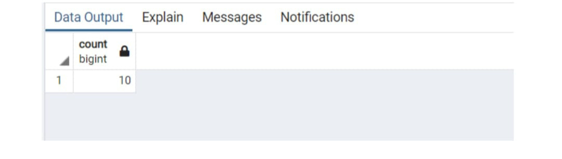
1 – Count the total number of customers in the bank
=> SELECT COUNT(CUSTOMER_ID) FROM CUSTOMER

Slide 26
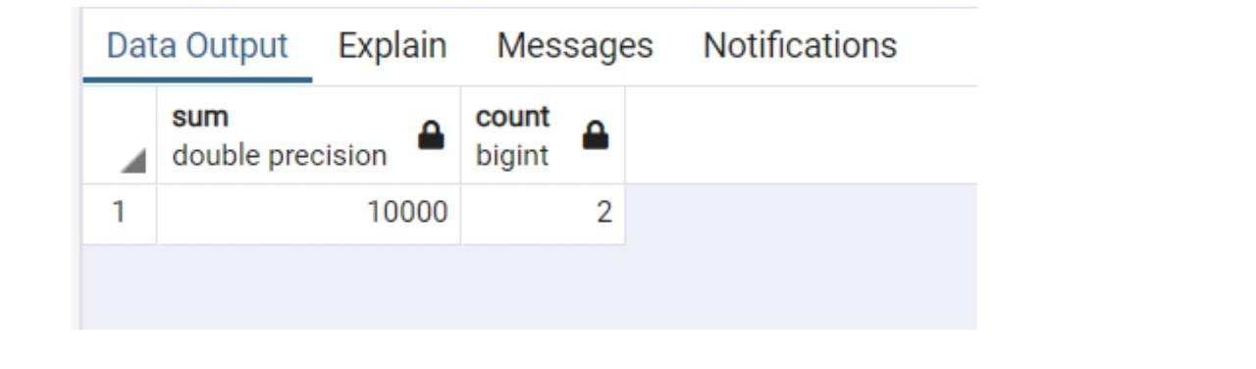
2- Find the sum of transaction where TRANSACTION_DATE='2018-12-20'
>SUM(TRANSACTION_AMOUNT),COUNT(TRANSACTION_AM OUNT) FROM TRANSACTIONS WHERE TRANSACTION_DATE='2018-12-20'

Slide 27
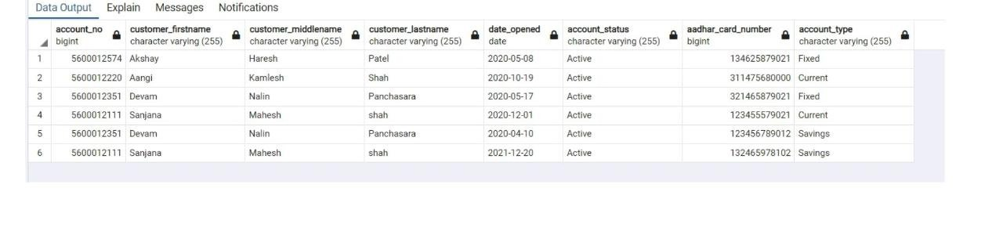
3 – Display the list of customers of customers who opened their accounts in between 2020-21.
=> SELECT * FROM customer AS C JOIN ACCOUNT_DETAILS AS A ON(C.CUSTOMER_ID=A.CUSTOMER_ID) where extract (YEAR from DATE_OPENED) between 2020 and 2021

Slide 28
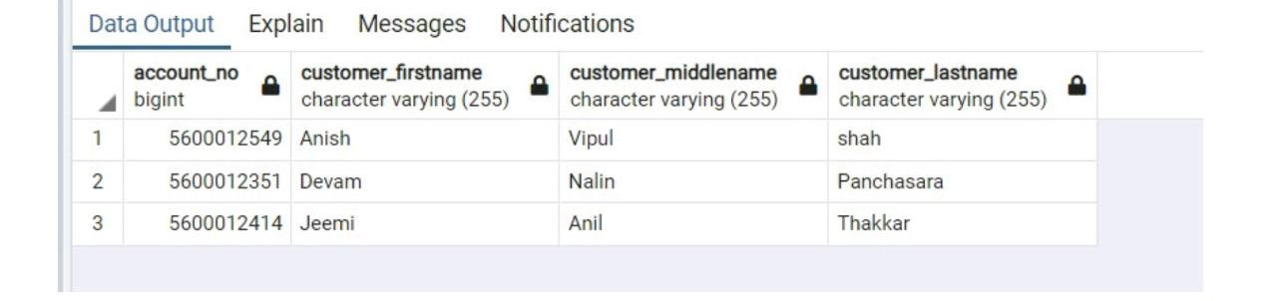
4 – Display the list of customers who have debit card.
=>SELECTACCOUNT_NO,CUSTOMER_FIRSTNAME,CUSTOMER_MIDDL ENAME,CUSTOMER_LASTNAME FROM CUSTOMER AS C JOIN CARDS AS CD ON(C.CUSTOMER_ID=CD.CUSTOMER_ID) WHERE CARD_TYPE='Debit'

Slide 29
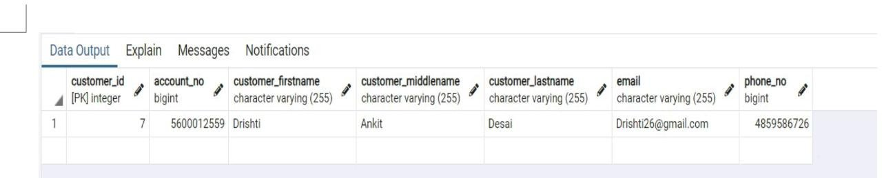
5 – Display the list of customers who used their credit card in September 2021.
=>SELECT * FROM TRANSACTIONS AS T JOIN ACCOUNT_DETAILS AS A ON(T.ACCOUNT_ID=A.ACCOUNT_ID) JOIN CUSTOMER AS C ON (C.CUSTOMER_ID=A.CUSTOMER_ID) WHERE extract (YEAR from TRANSACTION_DATE)=2021 AND extract (MONTH from TRANSACTION_DATE)=09 AND TRANSACTION_TYPE='CREDIT'

Slide 30
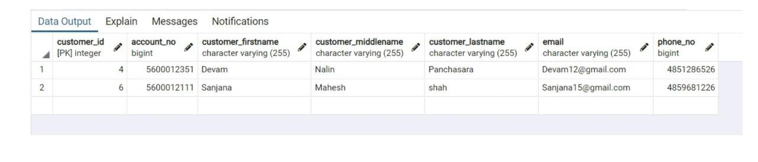
6 – Retrieve the customer details who has an account more than one branch.
=>SELECTC.CUSTOMER_ID,ACCOUNT_NO,CUSTOMER_FIRSTNAME,C USTOMER_MIDDLENAME,CUSTOMER_LASTNAME,EMAIL,C .PHONE_NO FROM CUSTOMER AS C JOIN ACCOUNT_DETAILS AS A ON(C.CUSTOMER_ID=A.CUSTOMER_ID) JOIN BRANCH AS B ON(A.BRANCH_ID=B.BRANCH_ID) GROUP BY C.CUSTOMER_ID HAVING COUNT(DISTINCT A.BRANCH_ID)>1 ;

Slide 31
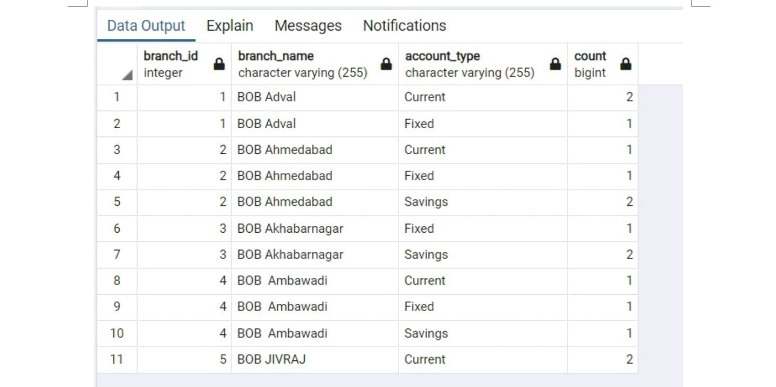
7 - COUNT TOTAL NO. OF ACCOUNT TYPES OF DIFF BRANCHES
=> SELECT B.BRANCH_ID,B.BRANCH_NAME,ACCOUNT_TYPE,COUNT(
ACCOUNT_TYPE) FROM ACCOUNT_DETAILS AS A JOIN
BRANCH AS B ON(A.BRANCH_ID=B.BRANCH_ID) GROUP BY
ACCOUNT_TYPE,B.BRANCH_ID ORDER BY BRANCH_ID

Slide 32
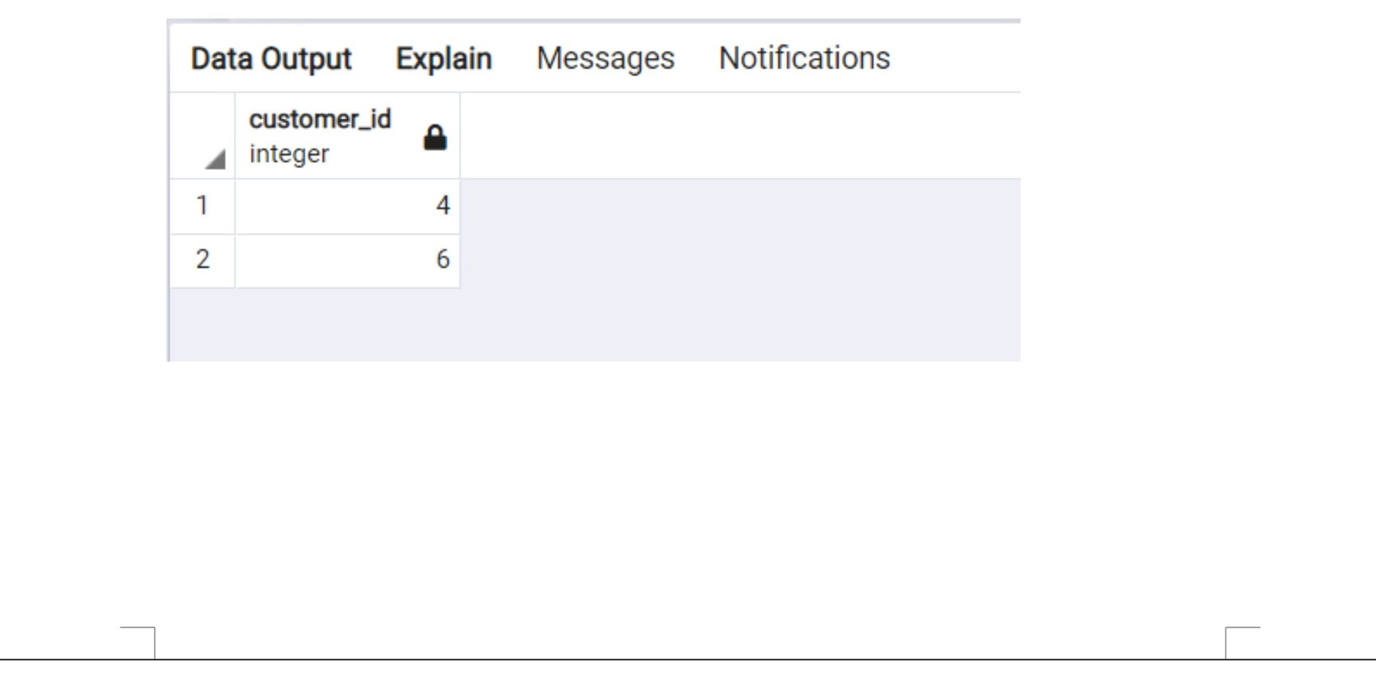
8 - List the customer_id who have both savings & current account
=> select customer_id from ACCOUNT_DETAILS where ACCOUNT_TYPE='Savings' intersect select customer_id from ACCOUNT_DETAILS where ACCOUNT_TYPE='Current

Slide 33
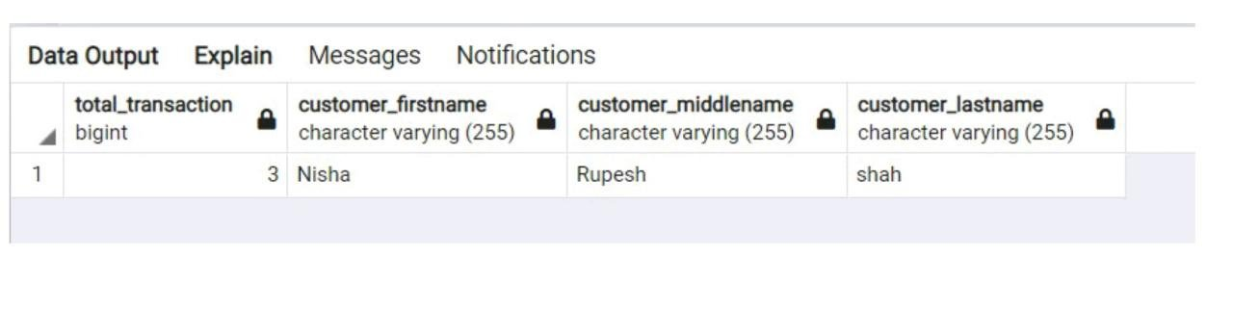
9 - FIND THE MAXIMUM COUNT OF TRANSACTION DONE
BY A CUSTOMER
=> SELECT COUNT(TRANSACTION_ID) AS
TOTAL_TRANSACTION,CUSTOMER_FIRSTNAME,CUSTOME
R_MIDDLENAME,CUSTOMER_LASTNAME FROM
TRANSACTIONS AS T JOIN ACCOUNT_DETAILS AS A ON
(T.ACCOUNT_ID=A.ACCOUNT_ID) JOIN CUSTOMER AS C
ON(A.CUSTOMER_ID=C.CUSTOMER_ID) GROUP BY
T.ACCOUNT_ID,C.CUSTOMER_ID ORDER BY
COUNT(TRANSACTION_ID) DESC LIMIT 1

Slide 34
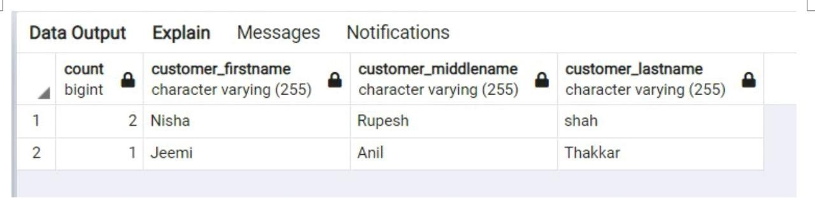
10 - FIND THE MAXIMUM COUNT OF TRANSACTION DONE BY A CUSTOMER USING CHEQUE
=> SELECT COUNT(TRANSACTION_ID),CUSTOMER_FIRSTNAME,CUSTO MER_MIDDLENAME,CUSTOMER_LASTNAME FROM TRANSACTIONS AS T JOIN ACCOUNT_DETAILS AS A ON (T.ACCOUNT_ID=A.ACCOUNT_ID) JOIN CUSTOMER AS C ON(A.CUSTOMER_ID=C.CUSTOMER_ID) WHERE TRANSACTION_TYPE='CHEQUE' GROUP BY T.ACCOUNT_ID,C.CUSTOMER_ID ORDER BY MAX(TRANSACTION_ID) DESC

Slide 35
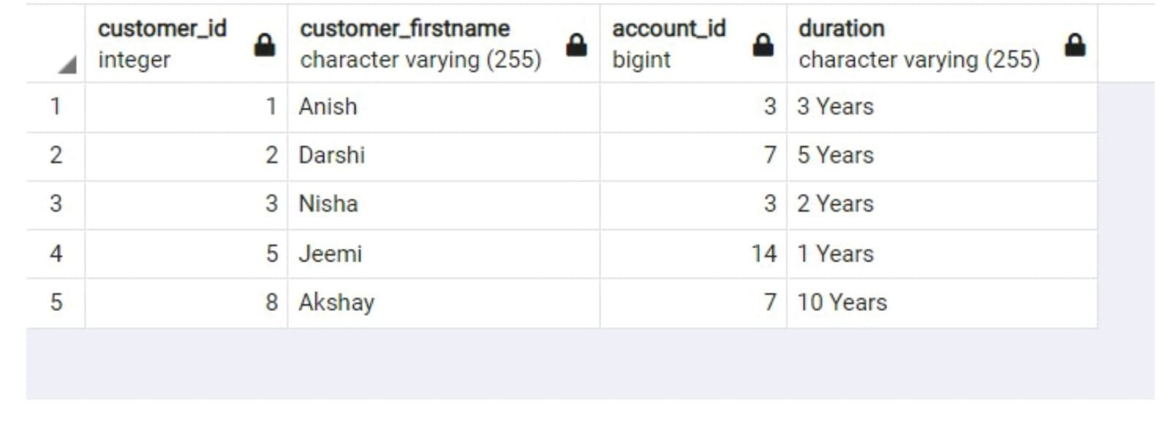
11- Write a query to display the customer’s id,customer’s firstname, account id and duration for people who have taken loans.
=> SELECT customer.customer_id, customer_firstname,account_details.account_id, loan.duration FROM ((loan INNER JOIN customer ON loan.customer_id=customer.customer_id) INNER JOIN account_details ON loan.account_id=account_details.account_id);

Slide 36
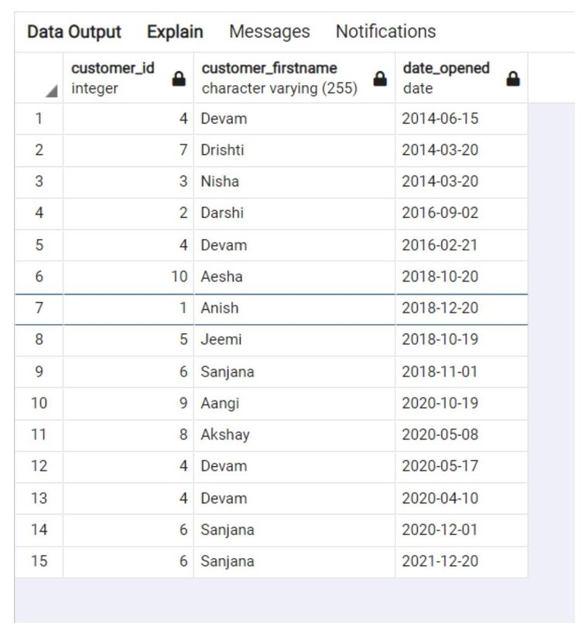
12- Write a query to display the customer id, firstname,
account_opened_date. Display in sorted order of date of account
opened and within that sort by firstname.
=> SELECT C.CUSTOMER_ID,C.CUSTOMER_FIRSTNAME,A.date_opened FROM Customer AS C JOIN ACCOUNT_DETAILS AS A ON(C.CUSTOMER_ID=A.CUSTOMER_ID) ORDER BY EXTRACT(year FROM date_opened), c.customer_firstname ASC;

Slide 37
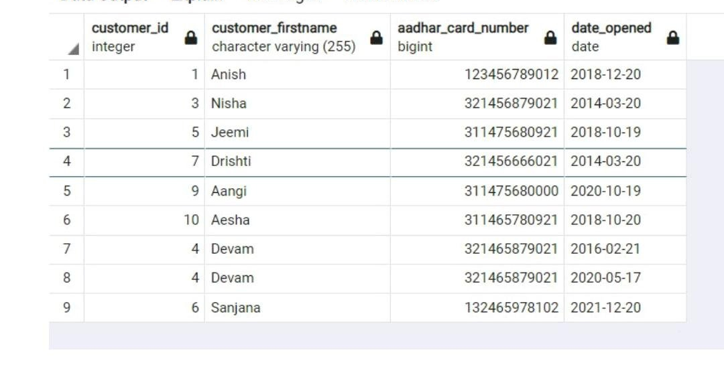
13- Write a query to display the customer id, customer firstname,account number for the customer’s whose accounts were created after 15th date of any month.
=> SELECT account_details.customer_id, customer.customer_firstname, account_details.aadhar_card_number,account_details.date_opened FROM account_details,customer WHERE account_details.customer_id = customer.customer_id AND EXTRACT (day FROM date_opened)>15;

Slide 38
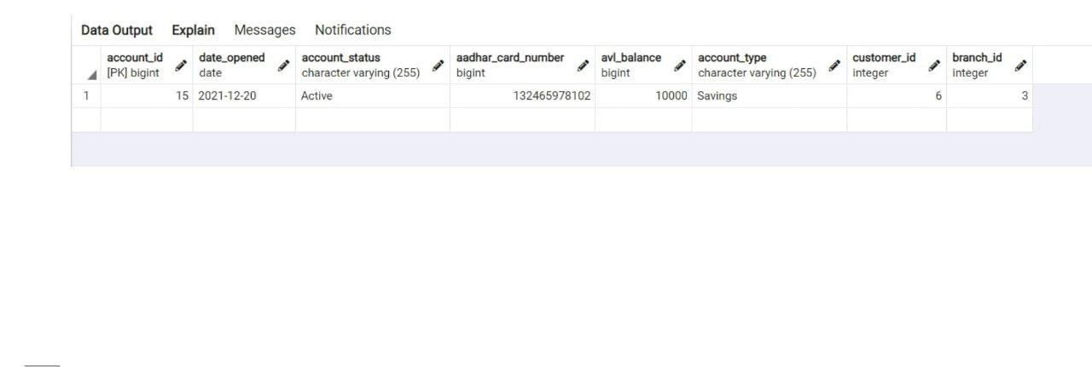
14 - write a query to dispplay the customer name who has highest balance
=> SELECT * FROM ACCOUNT_DETAILS GROUP BY ACCOUNT_ID HAVING AVL_BALANCE=(SELECT MAX(AVL_BALANCE) FROM ACCOUNT_DETAILS);

Slide 39
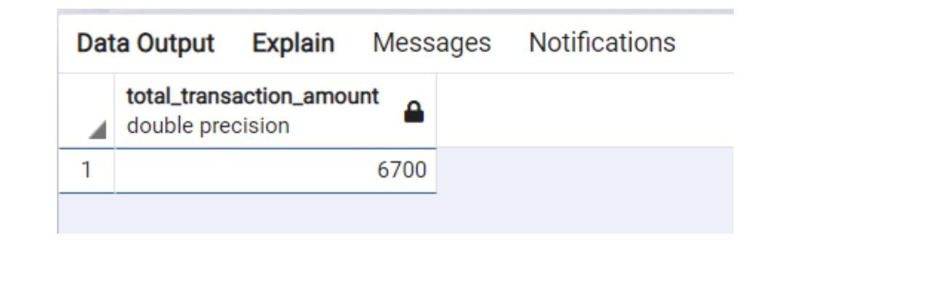
15 - FIND SUM OF TOTAL TOTAL_TRANSACTION_AMOUNT WHERE TRANSACTION MONTH 12/2021 AND 01/2021
=> SELECT SUM(TRANSACTION_AMOUNT) AS tOTAL_TRANSACTION_AMOUNT FROM TRANSACTIONS WHERE EXTRACT(YEAR FROM TRANSACTION_DATE)=2021 AND (EXTRACT(MONTH FROM TRANSACTION_DATE)=12 OR EXTRACT(MONTH FROM TRANSACTION_DATE)=01)

Slide 40
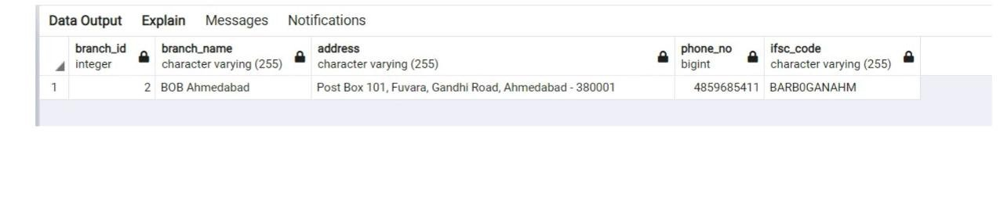
16 - DISPLAY THE BRANCH_DETAILS WHO GIVES MAXIMUM LOANS
=> SELECT A.BRANCH_ID,B.BRANCH_NAME,B.ADDRESS,B.PHONE_NO, B.IFSC_CODE FROM LOAN AS L JOIN ACCOUNT_DETAILS AS A ON(L.ACCOUNT_ID=A.ACCOUNT_ID) JOIN BRANCH AS B ON(A.BRANCH_ID=B.BRANCH_ID) GROUP BY A.BRANCH_ID,B.BRANCH_NAME,B.ADDRESS,B.PHONE_NO, B.IFSC_CODE ORDER BY COUNT(A.BRANCH_ID) DESC LIMIT 1

Slide 41
Thank You...

